Slide 1

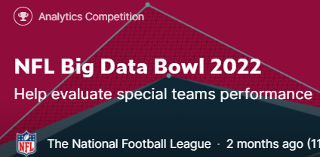
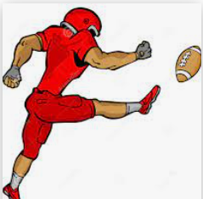
Ben Jenkins
2022 MS Data Science Practicum
“New Metrics for Kicker and Punter Performance”

Slide 2
New Metrics for Kicker and Punter Performance
Goal and Methodology
Punter Results
Machine Learning Model
Kicker Results

Slide 3
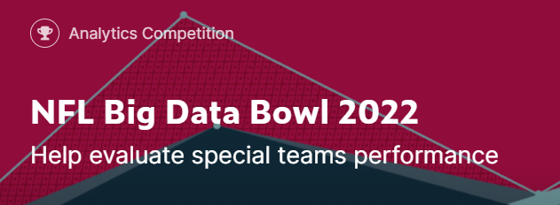
New Metrics for Kicker and Punter Performance
Goal Help NFL Evaluate Performance of Special Teams
Built New Metrics for Kickers and Punters
Ranked players and validated by player awards (Pro Bowl and All-Pro) and player salaries
Identified improving players for acquisition or contract extension and trade/release.
Provide real-time analysis of expected performance. Decision-making tool for teams to assess the tradeoffs of certain plays

Slide 4
Overview of Methodology:
Data from NFL's Next Gen Stats (NGS) tracking data
Collected from 2018-2020 special teams plays
RFID Location Information for each player, including speed, acceleration, and direction
Sampled every 0.1 seconds
Supplement with Weather data
Measured performance relative to the average performance.
Applied ensemble modeling techniques to identify variables that most affect play outcomes such as temperature, wind speed, and the relative locations of the offensive and defensive players.
Compute the expected performance for each play
Compare individual players performance to the expected performance
Developed probabilistic models of a player’s performance distribution.

Slide 5
New Punter Metrics
Expected Punt Yards (ePY): Expected punt yardage from machine learning model. Indicates how an average punter would perform in the same situation.
Punt Yards Over Expected (PYOE): Difference between the actual and expected punt yards.
Consistency: Measure of performance consistency through the standard deviation of PYOE in a given season.
Clutch: player’s performance over expected in the fourth quarter within a three-point game.
Ranked list of punters sorted by PYOE identifies standout players

Slide 6

New Punter Metric

Slide 7
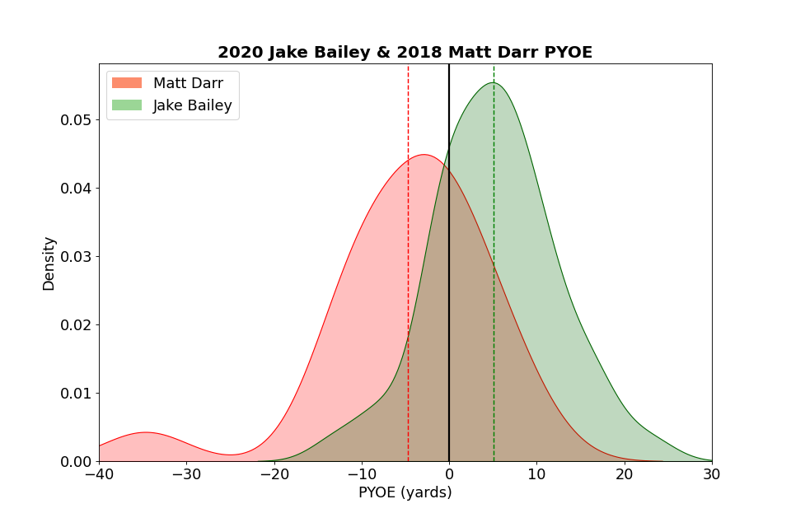
Punt Yards Over Expected (PYOE)
Average
Difference between the actual and expected punt yards over a season
Jake Bailey
Average
Matt Darr
Std = Consistency
Std = Consistency
PYOE (Yards)
-5 Yards
+5 Yards

Slide 8
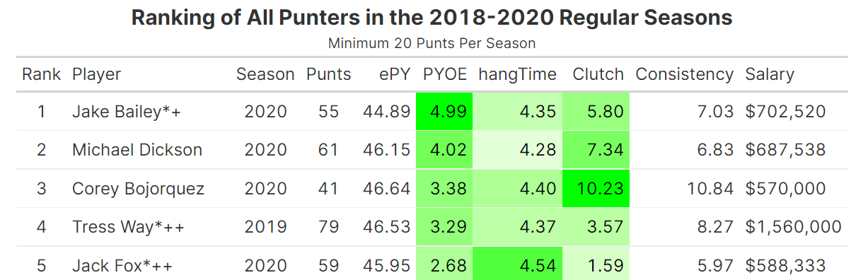
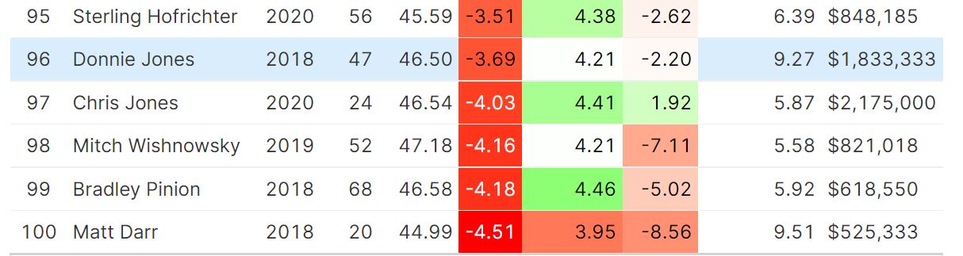
Results: Ranked List of Punters

Slide 9
Machine Learning
Kicking modeled as a classification task, field goal attempt is binary
Gradient boosting classification trees
Punting modeled as a regression task: punt yards is a continuous variable.
Gradient boosting regression trees
XGBoost ensemble modelling technique
Iteratively fits an ensemble of weak models to form a single strong one.
At each stage, it builds a weak learner that attempts to overcome the shortcomings of the previous model.
Able to detect complex nonlinear relationships
5-fold cross-validation for model evaluation and tuning

Slide 10
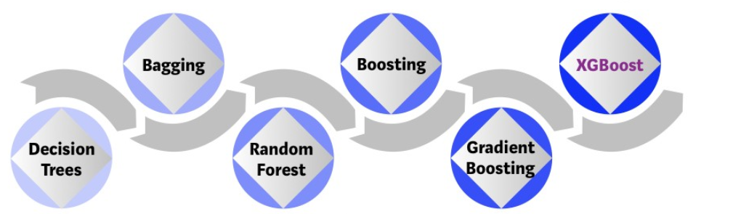
Evolution of XGBOOST
Reference: https://towardsdatascience.com/https-medium-com-vishalmorde-xgboost-algorithm-long-she-may-rein-edd9f99be63d

Slide 11
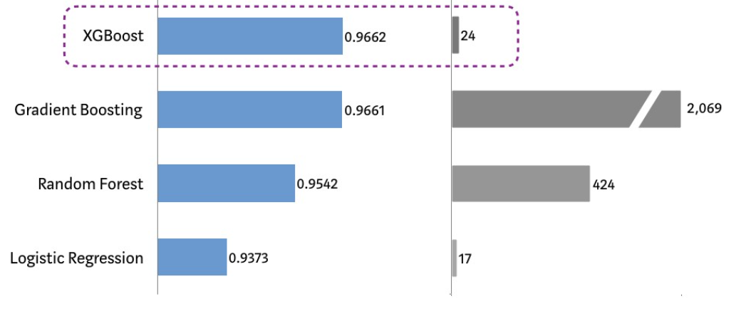
Benefits of XGBOOST
Predictive Power
Training Time (seconds)
Reference: https://towardsdatascience.com/https-medium-com-vishalmorde-xgboost-algorithm-long-she-may-rein-edd9f99be63d

Slide 12
Kick and Punt Model Features
Over 100 play features were considered to estimate performance.
A subset of these were found to have the most utility to extract signals and quantify the difficulty of a play.
SHAP (SHapley Additive exPlanations)
Identify the most important features, such as field goal distance.
Provide accurate local explanations (i.e how a prediction was made on a particular play).
For Example, Positive indicators of a successful field goal include:
A close field goal attempt
low wind speed high temperature,
low angle difference of the kicker (kicker moving and looking in the same direction)

Slide 13
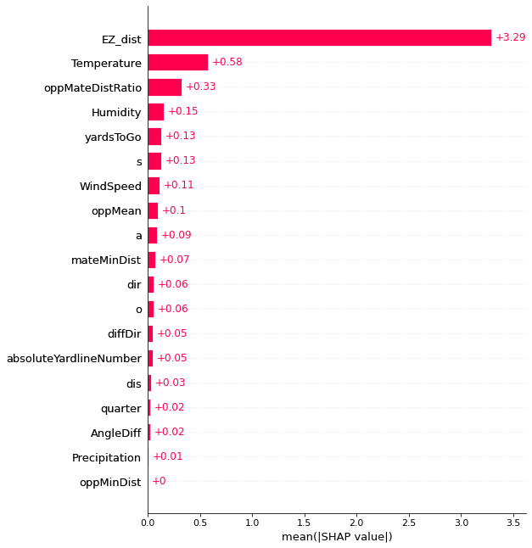
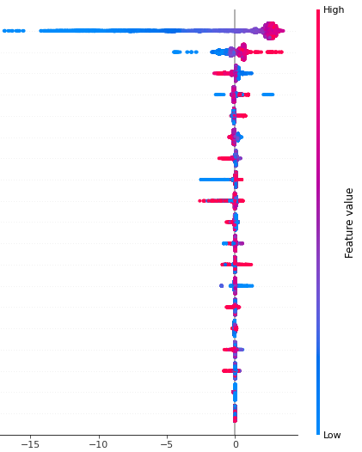
Punt Model SHAP Values
Magnitude of Impact
Range of Values & Impact
Distance
Temperature
Opposing Players

Slide 14
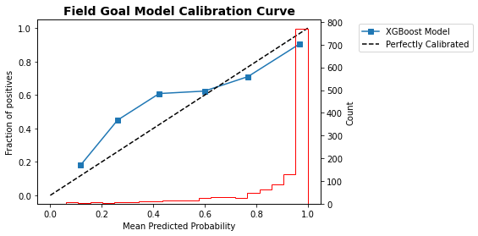
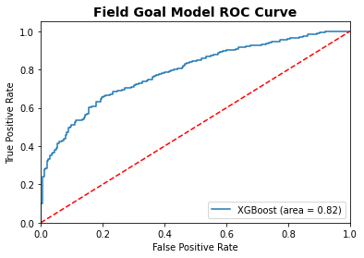
Model Evaluation
Classification models are optimized for log loss since we were primarily interested in the predicted probabilities. The field goal model has an AUC of 0.82, log loss of 0.33, and brier score loss of 0.104 on the evaluation set.
Predicted Probabilities
Random (area = 0.5)

Slide 15
New Kicker Metrics
Clutch and Consistency are computed using the same method as punters.
Field Goal Percentage Over Expected (FGOE): The difference between the actual and expected field goal percentage on every field goal attempt aggregated over each season.
Extra Point Percentage Over Expected (XPOE): The difference between the actual and expected extra point percentage on every extra point attempt aggregated over each season.
Total Contribution: The cumulative kicking performance over expected in a given season.

Slide 16
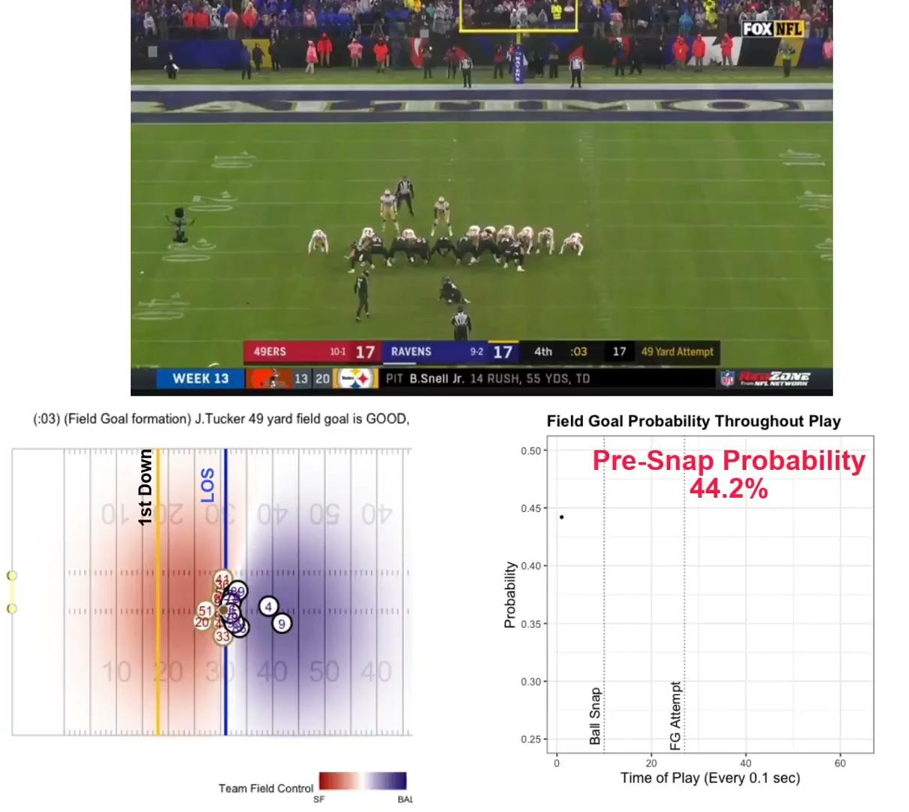
Kicker Metric: Field Goal Example

Slide 17
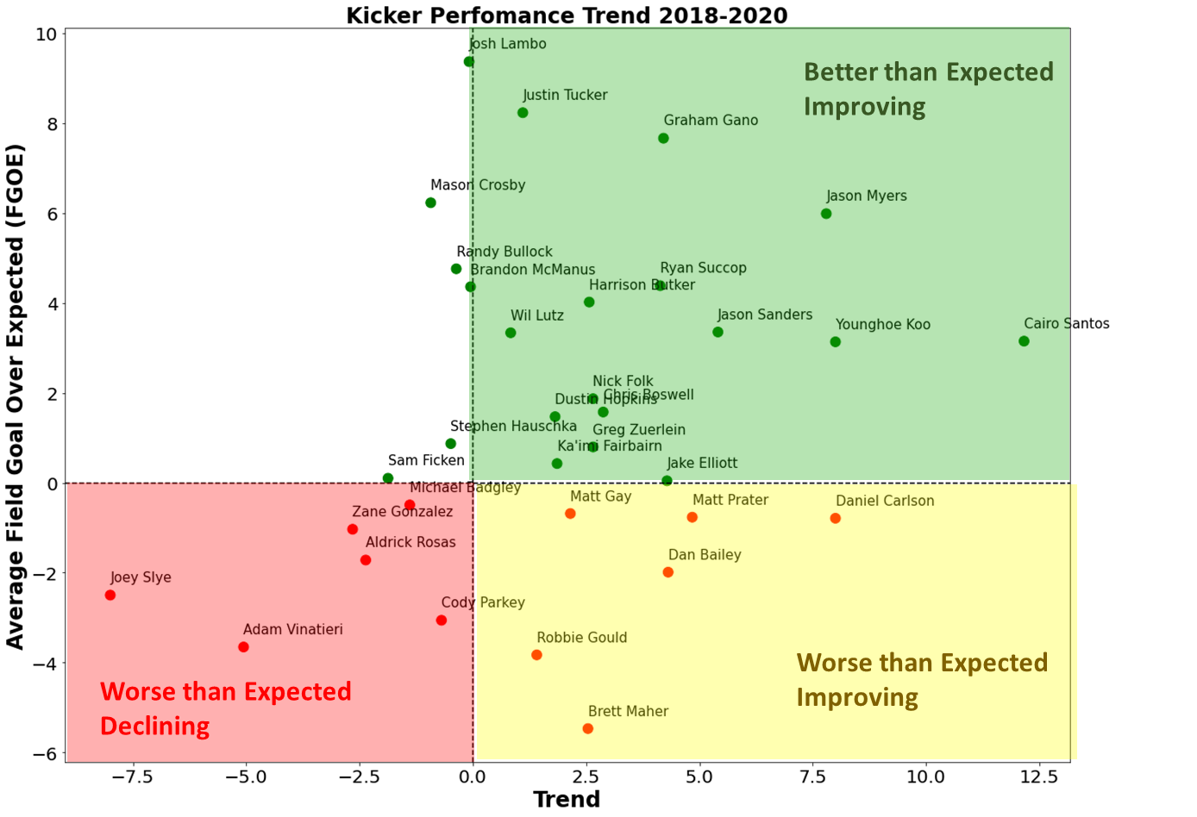
Kicker Performance Trend
Average Field Goal over Expected (FGOE)
Trend (Change in FGOE 2018-2020)

Slide 18
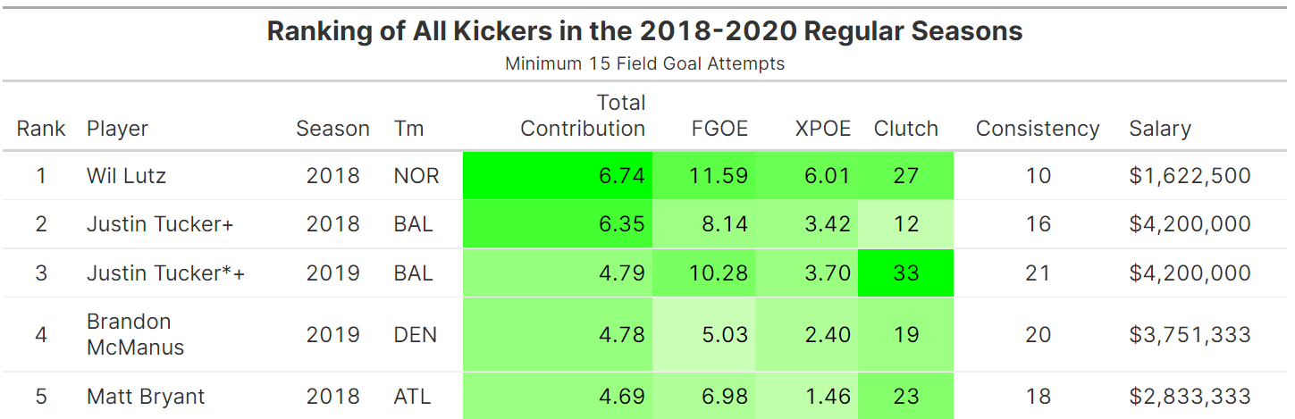
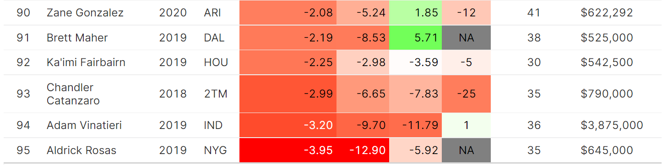
Results: Ranked List of Kickers

Slide 19
Conclusions: 2022 MS Data Science Thesis
New Metrics successfully compares individual players performance to the expected performance.
Results provide new insights into the performance of kickers and punters.
Teams can use for player evaluation, acquisition
Real-time game strategy.
Framework can be extended to other plays such as punt and kickoff returns. Other areas for future extension include a ghosting framework to compare player movements to optimal movements.
Deep learning techniques have shown strong predictive ability with player tracking data in the past and warrants further investigation.

Slide 20
Questions?

Slide 21
References
Announcement of 2022 NFL Big Data Bowl: https://www.kaggle.com/c/nfl-big-data-bowl-2022
Ben Jenkins Kaggle Worksheet: https://www.kaggle.com/benjenkins96/quantifying-kicker-and-punter-performance
XGBoost: A Scalable Tree Boosting System by Chin and Guestrin, 2016 https://arxiv.org/pdf/1603.02754.pdf
XGBoost Overview, October 2021 https://www.geeksforgeeks.org/xgboost/

Slide 22
BACKUP SLIDES

Slide 23
Kicker Metrics
Trend measures the change in a kicker's field goal over expected (FGOE) from the 2018-2020 seasons.
Indicates which players are improving and those that are declining.
Many of the best kickers are showing improvement
Some mediocre players are showing improvement, while some mediocre players are showing decline in performance.

Slide 24
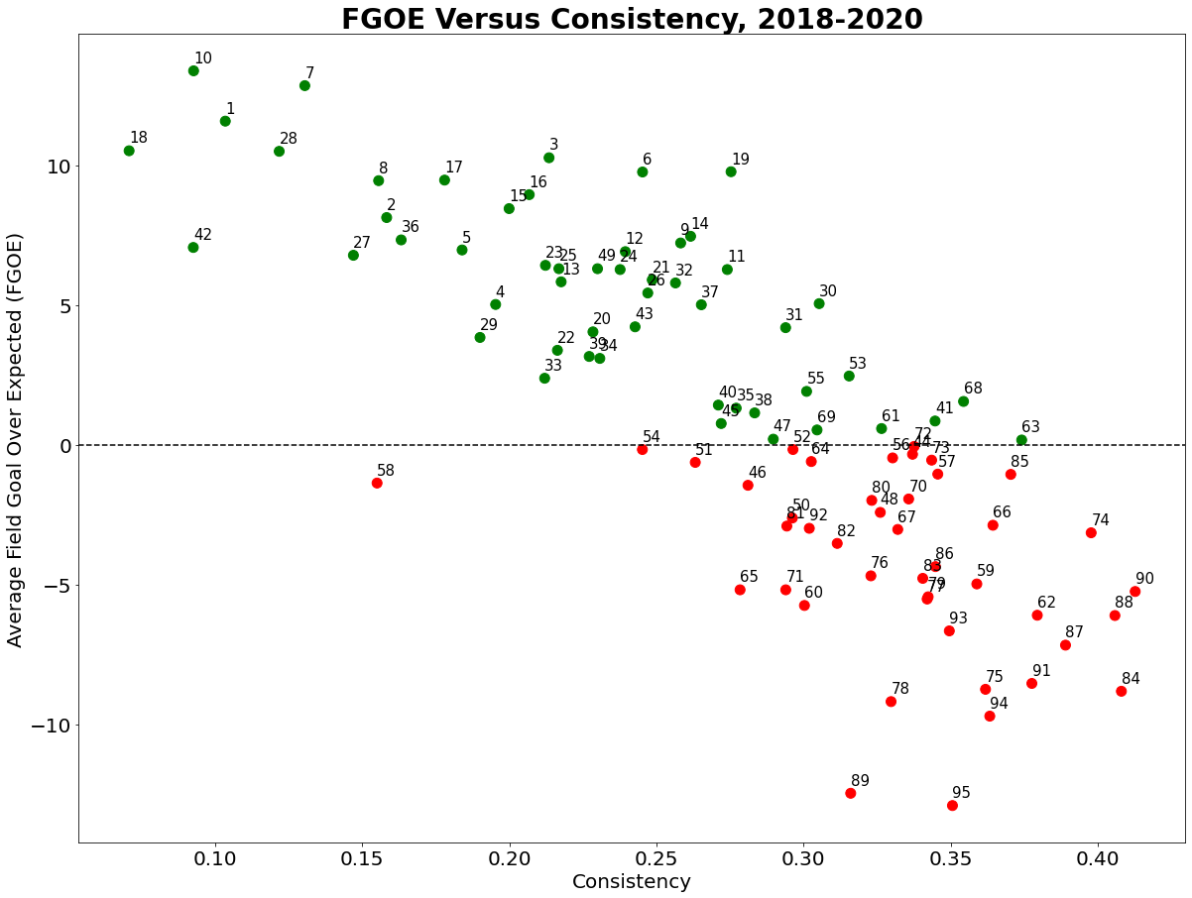

Slide 26
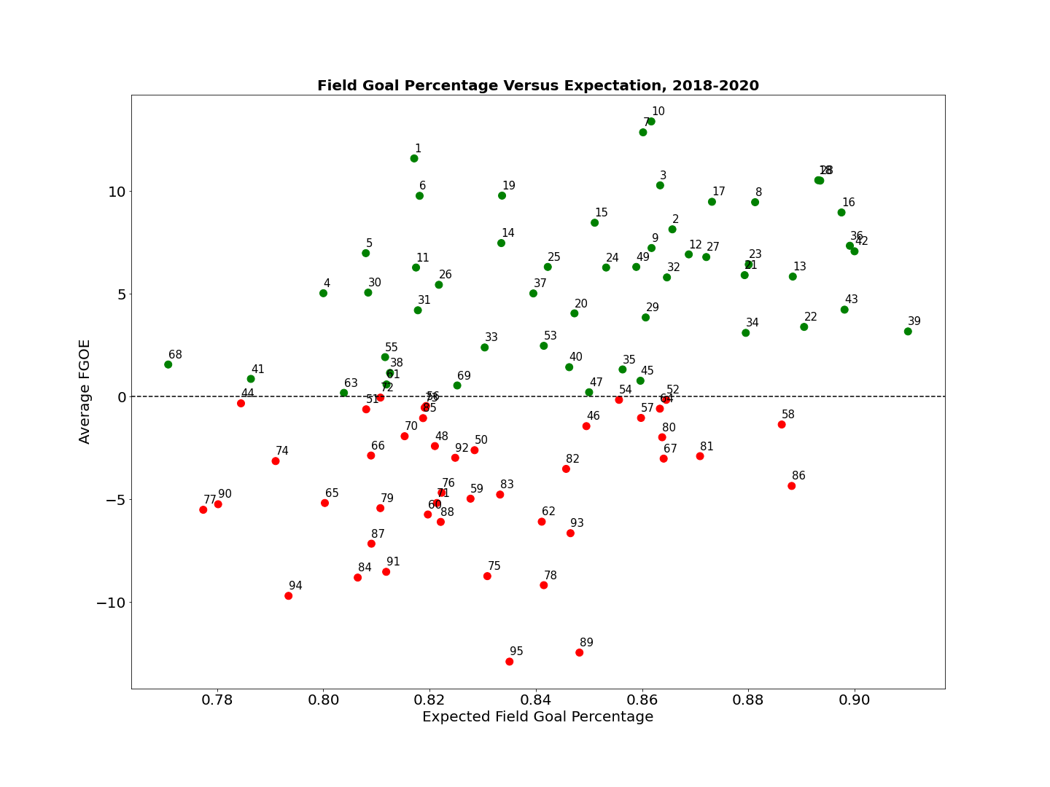
Field Goal Percentage Versus Expectation, 2018-2020
Better than Expected
Difficult FG’s
Graham Gano
2020
Jason Myers
2020
Better than Expected
Easier FG’s
Will Lutz
2018
Justin Tucker*+
2019
Mason Crosby
2020
Josh Lambo
2018
Jason Sanders+
2020
Justin Tucker+
2018
Aldrick Rosas*++
2018
Josh Lambo++
2019
Matt Bryant
2018
Brandon McManus
2019
Average Field Goal over Expected (FGOE)
Sam Ficken
2020
Jake Elliot
2020
Zane Gonzalez
2020
Eddy Pineiro
2019
Robbie Gould
2020
Chandler Catanzaro
2018
Adam Vinatieri
2019
Chris Boswell
2018
Worse than Expected
Difficult FG’s
Aldrick Rosas
2019
Worse than Expected
Easier FG’s
Robbie Gould
2019
Difficult Field Goals
Expected FG Percentage
Easier Field Goals
Field Goal Percentage Versus Expectation, 2018-2020 Seasons. Each circle represents an individual player's performance in a season and the numbers refer to their ranking in Figure 5. Kickers with better-than-expected performance (positive FGOE) are shown in the upper half of the figure and are represented by the green dots. Easier FG’s are shown on the right side of the plot, with higher expected FG percentage.

Slide 27
Results: Kick Play Example
The game-winning 49-yard field goal by Justin Tucker shows how the model could be used by teams in real-time to help make play decisions .
The model initially predicted a success probability of 44.2% due to the distance of the attempt and adverse weather conditions.
The field goal probability decreased initially from incoming pressure from Emmanuel Moseley (#41).
Conversely, we measure defensive performance by how much a player contributed to the decreased probability up to the attempt. Justin Tucker received a field goal percentage over expected (FGOE) of 0.53 aggregated over the play.

Slide 28
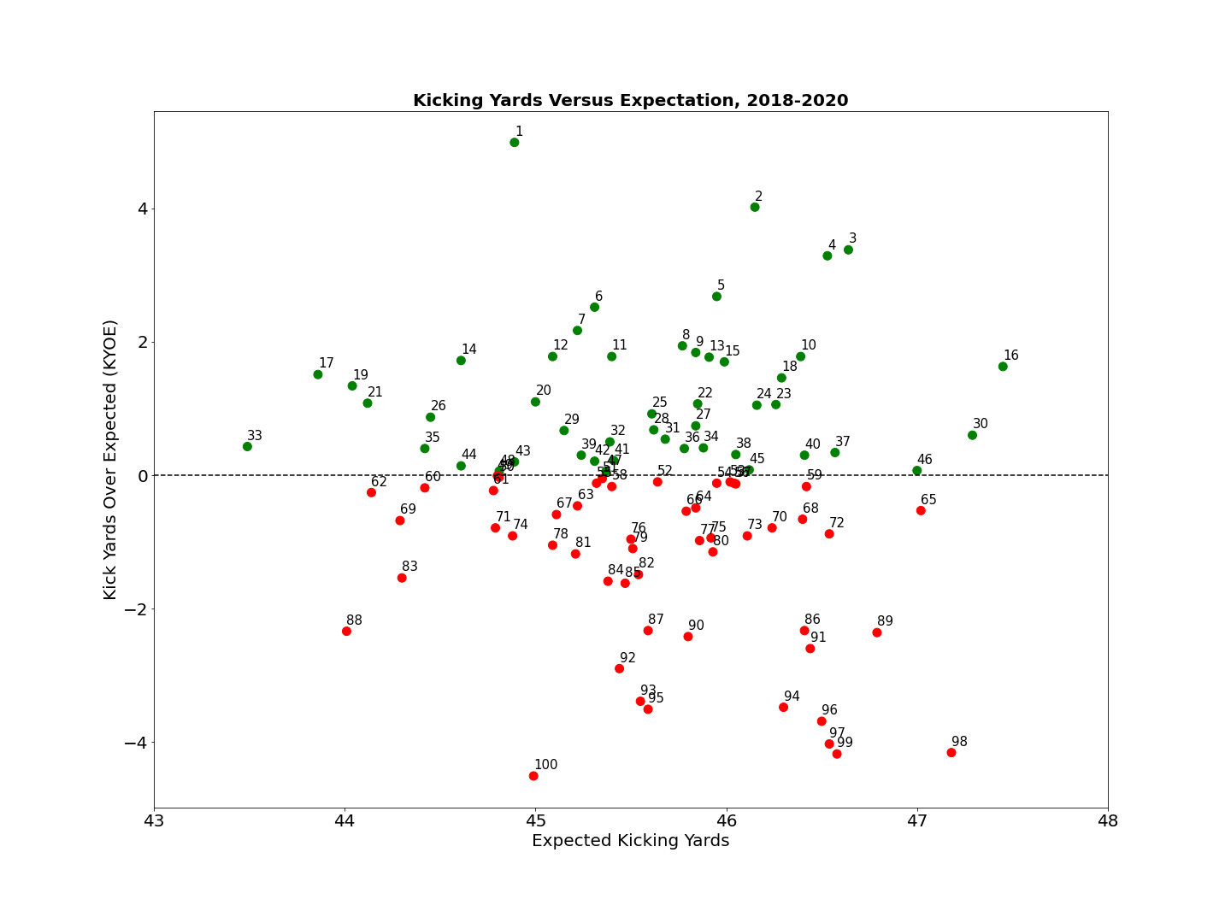
Jake Bailey*+ 2020
Michael Dickson 2020
Better
A.J. Cole 2019
Tress Way*++ 2019
Michael Dickson*+ 2018
Jack Fox*++ 2020
Andy Lee 2018
Average Kick Yards over Expected (KYOE)
Logan Cooke 2019
Worse
Chris Jones 2018
Corey Bojorquez 2019
Mitch Wishnowsk 2019
Matt Darr 2018
Difficult Punts
Expected Kicking Yards
Easier Punts

Slide 29
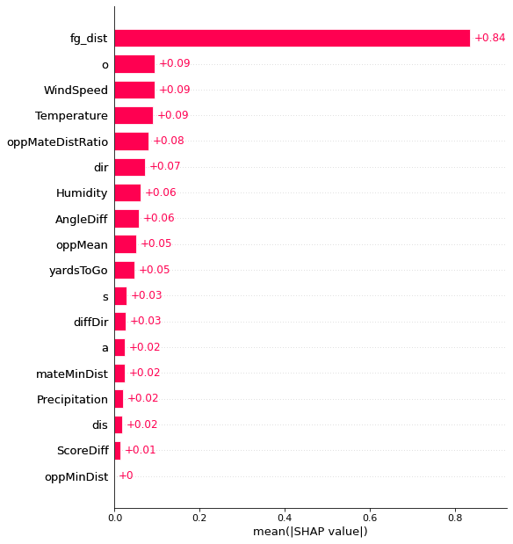
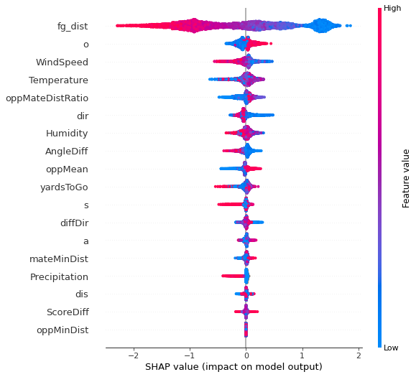
Field Goal Model SHAP Values
Magnitude of Impact
Range of Values & Impact
Distance
Orientation
Wind Speed

Slide 30
Results: Punter Metrics
hangTime: Average hangtime of player's punt in seconds.
Clutch: player’s performance over expected in the fourth quarter within a three-point game. The correlation between Clutch and punter performance is .63 indicating that the best punters often perform well in clutch situations.
Ranked list of punters sorted by PYOE identifies standout players include Jake Bailey in 2020, Michael Dickson, Corey Bojorquez (2020), Jack Fox (2020), and Brett Kern. Our metrics effectively identify the top kickers as reflected by individual player awards (as indicated by * and + symbols) and salary.

Slide 31
Punt Yards Versus Expectation, 2018-2020
Jake Bailey*+
2020
Michael Dickson
2020
Tress Way*++
2019
Better
Michael Dickson*+
2018
Corey Bojorquez
2020
A.J. Cole
2019
Jack Fox*++
2020
Sam Koch
2019
Brett Kern*
2020
Tress Way*
2020
Andy Lee
2018
Average Punting Yards over Expected (PYOE)
Colby Wadman
2018
Logan Cooke
2019
Ryan Allen
2019
Worse
Corey Bojorquez
2019
Thomas Morstead
2020
Chris Jones
2018
Sterling Hofrichter
2020
Matt Darr
2018
Bradley Pinion
2018
Mitch Wishnowsky
2019
Expected Punt Yards
Figure 3: Punt Yards Versus Expectation, 2018-2020 Seasons. Each circle represents an individual player's performance in a season, and the numbers refer to their ranking in Figure 2. Players above the zero horizontal line (highlighted in green) performed better than expected.

Slide 32
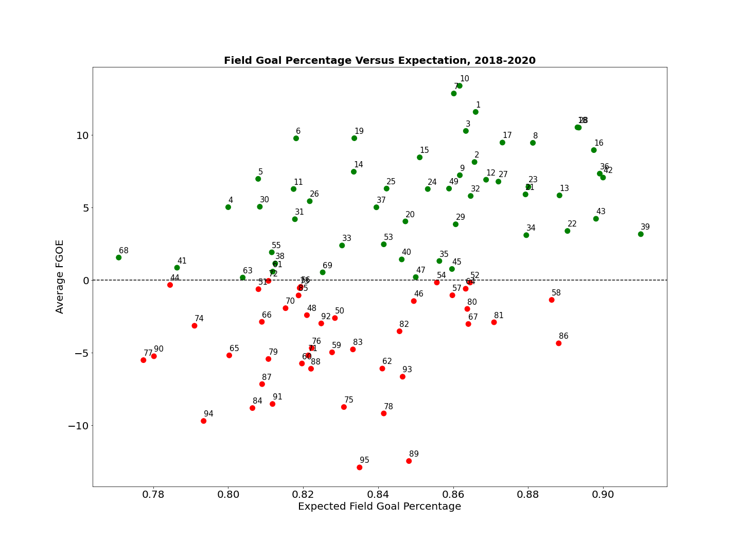
Field Goal Percentage Versus Expectation, 2018-2020
Graham Gano
2020
Jason Myers
2020
Jason Sanders+
2020
Justin Tucker*+
2019
Will Lutz
2018
Mason Crosby
2020
Josh Lambo
2018
Justin Tucker+
2018
Aldrick Rosas*++
2018
Josh Lambo++
2019
Matt Bryant
2018
Jason Myers*
2018
Better
Brandon McManus
2019
Average Field Goal over Expected (FGOE)
Sam Ficken
2020
Jake Elliot
2020
Eddy Pineiro
2019
Zane Gonzalez
2020
Worse
Robbie Gould
2020
Chandler Catanzaro
2018
Adam Vinatieri
2019
Chris Boswell
2018
Aldrick Rosas
2019
Robbie Gould
2019
Difficult Field Goals
Expected FG Percentage
Easier Field Goals

Slide 33
Field Goal Percentage Versus Expectation, 2018-2020
Graham Gano
2020
Jason Myers
2020
Will Lutz
2018
Justin Tucker*+
2019
Mason Crosby
2020
Jason Sanders+
2020
Josh Lambo
2018
Justin Tucker+
2018
Aldrick Rosas*++
2018
Josh Lambo++
2019
Matt Bryant
2018
Jason Myers*
2018
Better
Brandon McManus
2019
Average Field Goal over Expected (FGOE)
Sam Ficken
2020
Jake Elliot
2020
Zane Gonzalez
2020
Eddy Pineiro
2019
Worse
Robbie Gould
2020
Chandler Catanzaro
2018
Adam Vinatieri
2019
Chris Boswell
2018
Aldrick Rosas
2019
Robbie Gould
2019
Difficult Field Goals
Expected FG Percentage
Easier Field Goals
Figure 4: Field Goal Percentage Versus Expectation, 2018-2020 Seasons. Each circle represents an individual player's performance in a season, and the numbers refer to their ranking in Figure 5. Players above the zero horizontal line (highlighted in green) performed better than expected on their field goals. The further to the right on the figure indicates that their field goals were easier on average and vice versa. Individual players are named for reference.

Slide 36
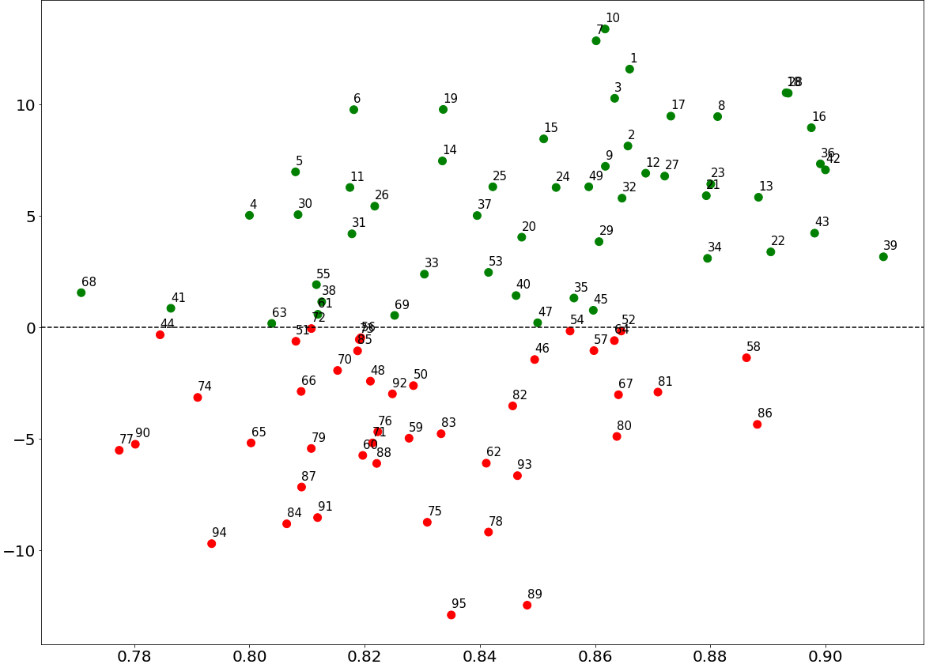

Slide 38
Punt Yards Versus Expectation, 2018-2020
Better than Expected
Short ePY
Jake Bailey*+
2020
Better than Expected
Long ePY
Michael Dickson
2020
Tress Way*++
2019
Michael Dickson*+
2018
Corey Bojorquez
2020
A.J. Cole
2019
Jack Fox*++
2020
Do Not show
Sam Koch
2019
Brett Kern*
2020
Tress Way*
2020
Andy Lee
2018
Average Punting Yards over Expected (PYOE)
Colby Wadman
2018
Logan Cooke
2019
Ryan Allen
2019
Corey Bojorquez
2019
Thomas Morstead
2020
Chris Jones
2018
Worse than Expected
Short ePY
Worse than Expected
Long ePY
Sterling Hofrichter
2020
Matt Darr
2018
Bradley Pinion
2018
Mitch Wishnowsky
2019
Expected Punt Yards (ePY)
Figure 3: Punt Yards Versus Expectation, 2018-2020 Seasons. Each circle represents an individual player's performance in a season, and the numbers refer to their ranking in Figure 2. Jake Bailey and Matt Darr have about the same expected punt yards (45 yards), but Jake performed above expectations. Punters with above expected yardage are shown in the upper half of the figure and are represented by the green dots. Some of the outstanding punters performed above expectations on longer punts (green shaded quadrant).

Slide 39
Jake Bailey*+ 2020
Michael Dickson 2020
A.J. Cole 2019
Tress Way*++ 2019
Better
Jack Fox*++ 2020
Michael Dickson*+ 2018
Andy Lee 2018
Average Kick Yards over Expected (KYOE)
Logan Cooke 2019
Chris Jones 2018
Worse
Corey Bojorquez 2019
Mitch Wishnowsk 2019
Matt Darr 2018
Difficult Punts
Easier Punts
Expected Kicking Yards

Slide 40
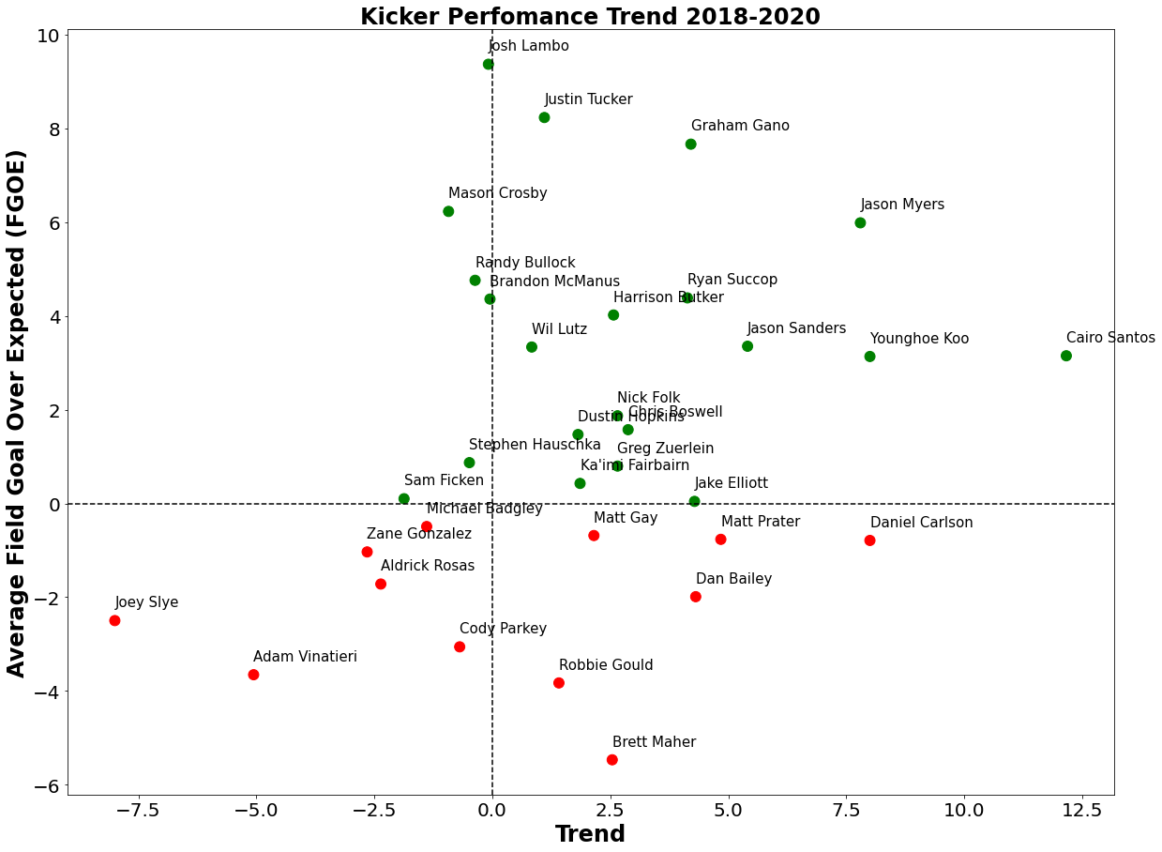
Good
Average Field Goal over Expected (FGOE)
Bad
Trend (Change in FGOE 2018-2020)

Slide 41
Figure 2: Punter Rankings from 2018-20 Seasons. This list is sorted by performance for each season. Each ranked player had a minimum of 20 punts in a season. Players with the best performance metric are shown with a green highlight, and the players with the relatively poorer performance are shown with a red highlight. In some cases, players did not have a sufficient sample size (number of plays) to compute a clutch metric and this is shown by NA.

Slide 42
Figure 3: Punt Yards Versus Expectation, 2018-2020 Seasons. Each circle represents an individual player's performance in a season, and the numbers refer to their ranking in Figure 2. Players above the zero horizontal line (highlighted in green) performed better than expected.

Slide 43
Figure 4: Field Goal Percentage Versus Expectation, 2018-2020 Seasons. Each circle represents an individual player's performance in a season, and the numbers refer to their ranking in Figure 4. Players above the zero horizontal line (highlighted in green) performed better than expected on their field goals. The further to the right on the figure indicates that their field goals were easier on average and vice versa. Individual players are named for reference.

Slide 44
Figure 5: Kicker Rankings from 2018-20 Seasons. This list is sorted by performance for each season. Each ranked player had a minimum of 15 Field goals in a season. Players with the best performance metric are shown with a green highlight, and the players with the relatively poorer performance are shown with a red highlight. In some cases, players did not have a sufficient sample size (number of plays) to compute a clutch metric and this is shown by NA.

Slide 45
Results: Punt Play Example
We adapt the space ownership technique from soccer as pressure from opposing players is a key factor in the outcome of a play. It quantifies the space that players have to operate. We output a probability of control for every location on the field by considering the location, velocity, and distance to the ball for all 22 players.
A 71-yard punt play from Jake Bailey illustrates punter performance allocation and the effect of incoming pressure (Figure 10).
The punt length was initially predicted at 48.8 yards, slightly longer than average, given the distance to the end zone and decent weather conditions.
The prediction decreases significantly after the snap up to the punt from pressure from Ogbonnia Okoronkwo (#45) of the LA Rams.
Jake Bailey received 27.5 punt yards over expected (PYOE) aggregated over the play.

Slide 46
Figure 6: Field Goal Model Feature Importance. Features (SHAP values) are ranked by average importance (shown on left figure). Weather conditions, field goal distance, and pressure from opposing defenders are the most important predictors. The density scatter-plot (right figure) shows how the range of values of the feature impact a successful field goal. Farther field goals, high wind speed, colder temperatures negatively impact the prediction of a successful field goal (as shown in red).

Slide 47
Figure 7: Punt Model Feature Importance. Features (SHAP values) are ranked by average importance (shown on left figure). Distance from the end zone, temperature and proximity of opposing players are key for punt distance. The density scatter-plot (right figure) shows how the range of values of the feature impact the punt. Farther end-zone distance, colder temperatures and close proximity of defenders negatively impact the predicted punt distance.

Slide 49
Figure 9: Jake Bailey 71-Yard Punt Versus LA Rams. Predictions are made every tenth of a second.
Figure 8: Justin Tucker Game-Winning 49 Yard Field Goal Attempt. Predictions are made every tenth of a second up to the attempt and out of sample. The pressure can be seen in the actual play as well as the field control model

Slide 50
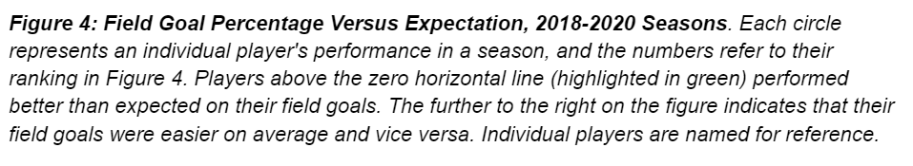
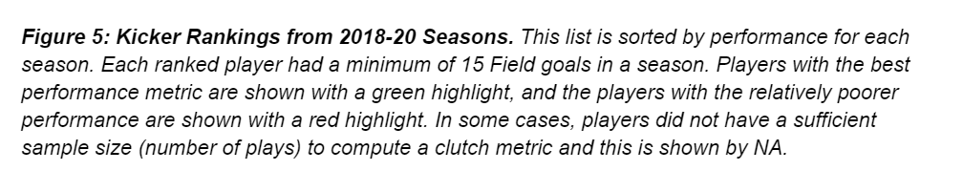
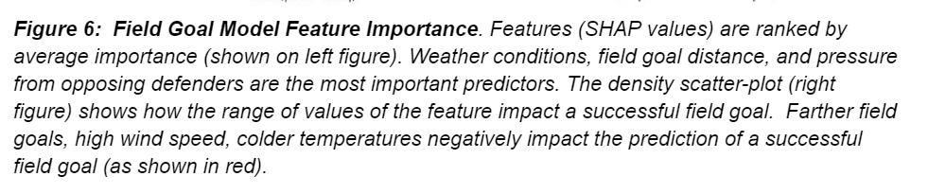

Slide 51
Methodology: 2022 MS Data Science Thesis
Kicking modeled as a classification task since the outcome of a field goal attempt is binary (either made or miss).
Kicker Metrics: Gradient boosting classification trees (XGBoost)
Punting modeled as a regression task: punt yards is a continuous variable.
Punter Metrics: Gradient boosting regression trees (XGBoost)
XGBoost's able to detect complex nonlinear relationships
5-fold cross-validation for model evaluation and tuning
Old Slide

Slide 52
Methodology
Kicking modeled as a classification task, the outcome of a field goal attempt is binary (either made or miss).
Gradient boosting classification trees
Punting modeled as a regression task: punt yards is a continuous variable.
Gradient boosting regression trees
XGBoost ensemble modelling technique
Attempts to build a strong classifier from a number of weak classifiers in series
Initial model is built from the training data, Second model is built which tries to correct the errors present in the first model.
Procedure is continued until either the complete training data set is predicted correctly
Able to detect complex nonlinear relationships
5-fold cross-validation for model evaluation and tuning

Slide 53
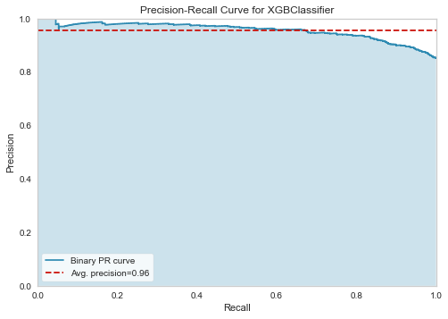
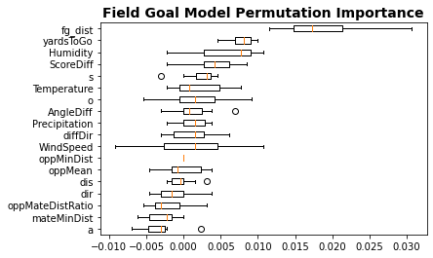

Slide 55
Model Evaluation
Classification models are optimized for log loss since we were primarily interested in the predicted probabilities. Field goals are easier to predict than extra points (extra points are missed much less frequently). The field goal model has an AUC of 0.82, log loss of 0.33, and brier score loss of 0.104 on the evaluation set. The extra point model has an AUC of 0.63, log loss of 0.24, and brier score loss of 0.06 on the evaluation set.
The area under the curve of a receiver operating characteristic (ROC AUC) is a common classification metric and is particularly well suited for imbalanced tasks (such as predicting whether an extra point will be made or missed). AUC compares the true positive rate and false positive rate of a classifier. A perfect model has an AUC of 1 while a random classifier has an AUC of 0.5. The field goal model has an AUC of 0.82 on data witheld from training.
Permutation importance measures how much a performance score decreases when a feature isn't available. Feature is replaced with random noise (permuted) and measures how the performance changes when the feature is replaced. This is calculated on the test set after the model has been fit. An issue with this method is that it may understate the importance of certain features if there is multicollinearity. SHAP is the preferred method when dealing with multicollinearity and identifying interactions in data

Slide 56
Average
Average

Slide 57
Results: Punt Play Example
71-yard punt play from Jake Bailey, Patriots vs Rams, 2020 season.
A video of the play is on top, an animation of play with colored control of field on lower left, and a punt length prediction during the play on the lower right.
The model initially predicted a punt length of 48.8 yards as shown on the lower right.
Note the predicted punt length then decreases to 40 yards at the moment of the punt due to pressure from from Ogbonnia Okoronkwo (#45) as shown on the field animation.
Bailey received 27.5 punt yards over expected (PYOE) for this play

Slide 58
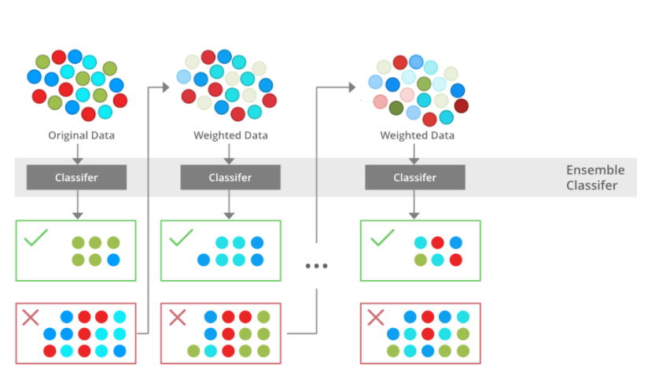
XGBOOST
Reference: https://www.geeksforgeeks.org/xgboost/

Slide 59
Overview: 2022 MS Data Science Thesis
Goal: Build metrics to improve evaluation of kickers and punters
Data: NFL's Next Gen Stats (NGS) tracking data from all 2018-2020 special teams plays: location information for each player, including speed, acceleration, and direction & weather data. Sampled every 0.1 seconds
Methodology: Apply Advanced statistical techniques
(1) Compute the expected performance for each play
(2) Compare individual players performance to the expected performance

Slide 60
Summary:
Measured performance relative to the average performance in the same play situation.
Applied ensemble modeling techniques to identify variables that most affect play outcomes; such as temperature, wind speed, and the relative locations of the offensive and defensive players.
Developed probabilistic models of a player’s performance distribution.
Important Results for NFL Teams
Ranked players and validated by player awards, such as Pro Bowl and All-Pro, and player salaries; identifies players for acquisition or contract extension and trade/release.
Provide real-time analysis of expected performance. Decision-making tool for teams to assess the tradeoffs of certain plays

